Slide 1
Queueing Theory
Data Analysis & Modeling Techniques

Slide 2
Queueing Systems
Queueing theory is concerned with the study of the behavior of queueing systems
Queueing systems model a wide range of systems
Supermarket lines
Traffic lights
Computer network traffic
Queueing theory is concerned with modeling the behavior of elements in these queueing systems
Queue length
Delay times
Wait times
Drop rates

Slide 3
Queueing Systems
A single queueing system is generally described by two random processes and a queue
Arrival process – describes the random process governing the arrival of elements
Service process – describes the random process governing the servicing (and thus departure) of elements
Queue – describing the properties of the waiting area
Queueing networks are networks of connected queueing systems where the departures from one queue can route to another queue
Queueing networks model complex queueing systems
Network traffic routing through multiple routers/switches
Traffic planning with multiple sequential traffic lights

Slide 4
Queueing Notation
A single queueing system can be characterized in terms of a number of characteristics
Arrival process – a description of the random process characterizing the arrival times of elements
Service process – a description of the random process characterizing the service characteristics (usually the service time) for an element
Number of servers – the number of elements that can be serviced simultaneously
System capacity – the total number of elements that can be in the system (waiting for or being serviced)
Population size – total number of elements
Queue discipline – the way waiting elements are picked for service, e.g. FIFO, LIFO, Round Robin

Slide 5
Queueing Notation
Depending on the characteristics, single queueing systems can be categorized in different classes
Kendall’s notation is generally used to characterize queueing systems
A/B/C/K/N/D
A – Arrival process class
B – Service process distribution
C – Number of servers
K – System capacity
N – Population
D – Queue discipline

Slide 6
Queueing Analysis
Different types of queues are differently difficult to analyze due to the characteristics of the arrival and service processes
Queueing systems can be analyzed in different dynamic states
Steady-state – the situation where the probability distribution of the system state is stationary (and thus does not vary over time).
Dynamic transition – the situation where the characteristics of the arrival process or the service time change
In general, transitional dynamics are much harder to analyze and basic queueing theory therefore focuses on the steady-state case

Slide 7
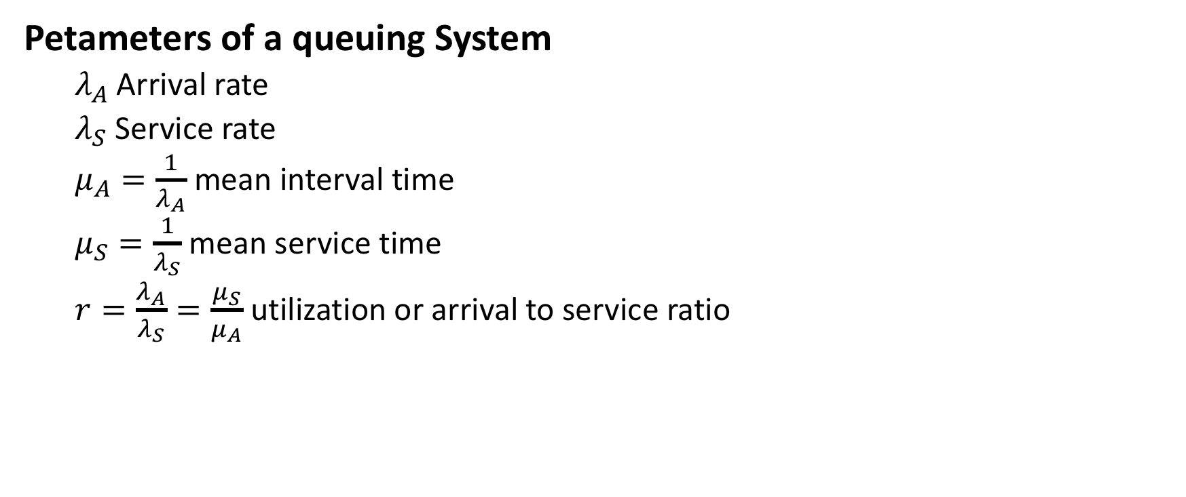
Queuing Process
Petameters of a queuing System
$λ_{A}$ Arrival rate
$λ_{S}$ Service rate
$μ_{A}=\frac{1}{λ_{A}}$ mean interval time
$μ_{S}=\frac{1}{λ_{S}}$ mean service time
$r=\frac{λ_{A}}{λ_{S}}=\frac{μ_{S}}{μ_{A}}$ utilization or arrival to service ratio

Slide 8
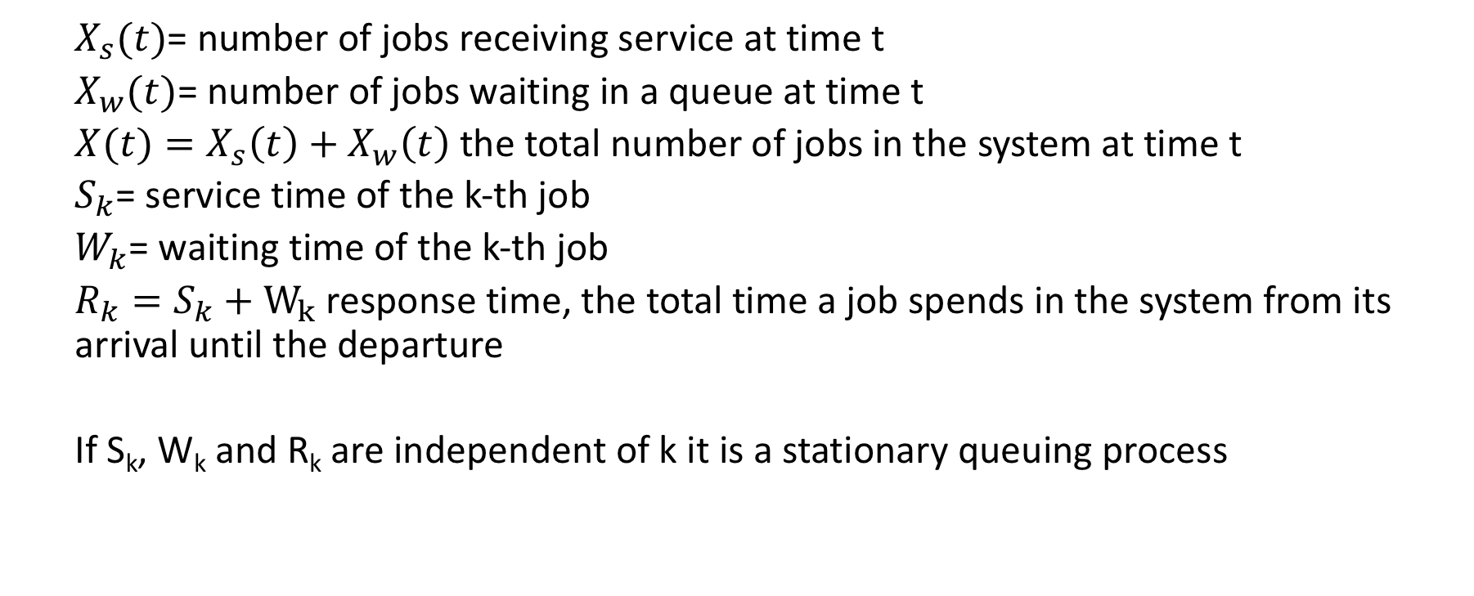
Random variables of a queuing system
$X_{s}(t)$= number of jobs receiving service at time t
$X_{w}(t)$= number of jobs waiting in a queue at time t
$X(t)=X_{s}\left(t\right)+X_{w}\left(t\right)$ the total number of jobs in the system at time t
$S_{k}$= service time of the k-th job
$W_{k}$= waiting time of the k-th job
$R_{k}=S_{k}+W_{k}$ response time, the total time a job spends in the system from its arrival until the departure
If S_{k}, W_{k} and R_{k} are independent of k it is a stationary queuing process

Slide 9
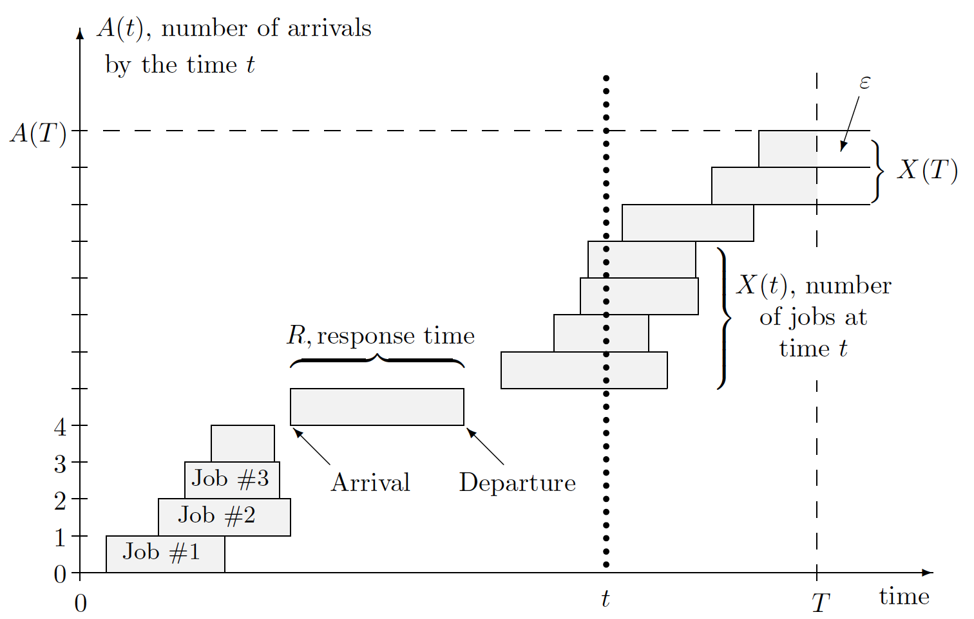
Queuing system and the illustration to the Little’s Law

Slide 10


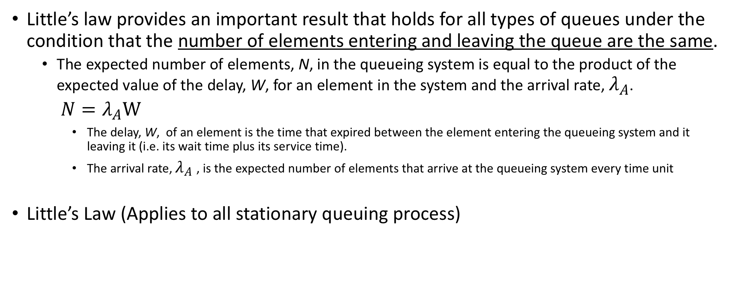
Little’s Law
Little’s law provides an important result that holds for all types of queues under the condition that the number of elements entering and leaving the queue are the same.
The expected number of elements, N, in the queueing system is equal to the product of the expected value of the delay, W, for an element in the system and the arrival rate, $λ_{A}$.
${N=λ}_{A}W$
The delay, W, of an element is the time that expired between the element entering the queueing system and it leaving it (i.e. its wait time plus its service time).
The arrival rate, $λ_{A}$ , is the expected number of elements that arrive at the queueing system every time unit
Little’s Law (Applies to all stationary queuing process)

Slide 11
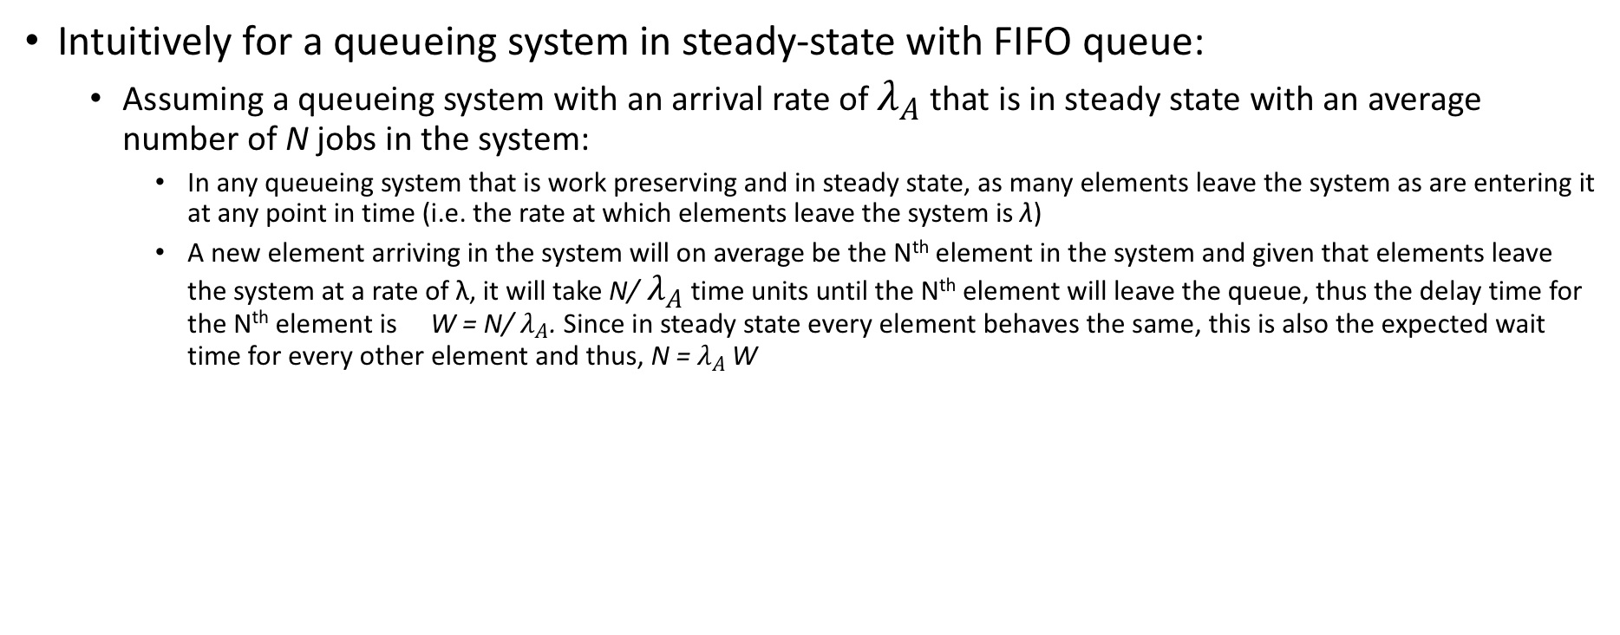
Little’s Law
Intuitively for a queueing system in steady-state with FIFO queue:
Assuming a queueing system with an arrival rate of $λ_{A}$ that is in steady state with an average number of N jobs in the system:
In any queueing system that is work preserving and in steady state, as many elements leave the system as are entering it at any point in time (i.e. the rate at which elements leave the system is λ)
A new element arriving in the system will on average be the N^{th} element in the system and given that elements leave the system at a rate of λ, it will take N/ $λ_{A}$ time units until the N^{th} element will leave the queue, thus the delay time for the N^{th} element is W = N/ $λ_{A}$. Since in steady state every element behaves the same, this is also the expected wait time for every other element and thus, N = $λ_{A}$ W

Slide 12
Queueing System Types
Some of the simplest to analyze and most commonly used queueing system types are ones with Markov arrival and service processes
The simplest Markov process model is the memoryless model using Poisson processes to describe the arrival and service processes
Arrival and service times follow exponential distributions with rates λ, μ, respectively
Memoryless Markov processes are usually indicated using the letter M in the arrival and service process fields of the Kendall notation.
Other frequently studied types use either the Erlang distribution (indicated by E) or deterministic or fixed interval processes (indicated by D)

Slide 13
Markov Queues
For Markov arrival and service processes, the likelihood of an element arriving in or leaving the system is determined by the state of the queue.
For a rate of η the probability would be η*dt.
The likelihood of a particular change of the state of the queue is therefor proportional to the arrival and service rate, respectively
This queueing system can be represented as a Markov chain where states indicate the number of elements in the system.
Transition probabilities to the next higher state are proportional to the arrival rate
Transition probabilities to the next lower state are proportional to the service rate

Slide 14
Markov Queues
In this model, only one transition can happen at any point in time; either an arrival or a departure
This is a realistic model for a Poisson distribution if dt is sufficiently small, i.e. tends towards 0.
Since dt represents a scaling factor to adjust for the time interval, this model is often written without the dt
λ₀dt
λ₁dt
λ₂dt
λ₃dt
λ₄dt
0
1
2
3
4
μ₁dt
μ₂dt
μ₃dt
μ₄dt
μ₅dt

Slide 15
Markov Queues
If the queue is in steady state, the probability to be in a given state, P(i), is a constant
The expected number of elements leaving a state has to be the same as the expected number entering it
The expected number of elements crossing upwards between two states is the same as the number crossing downwards
λ₀dt
λ₁dt
λ₂dt
λ₃dt
λ₄dt
0
1
2
3
4
μ₁dt
μ₂dt
μ₃dt
μ₄dt
μ₅dt

Slide 16
M/M/1 Queueing Systems
λ
λ
λ
λ
λ
An M/M/1 queue has 1 server and arrival and service are Poisson with the same rate for every state
Using the utilization , the probability of a state is
To determine P(0)
0
1
2
3
4
μ
μ
μ
μ
μ

Slide 17
M/M/1 Queueing Systems
Given this steady state probability distribution over queue states a number of questions can be answered
To reach a stable distribution (and thus steady state):
The expected number of elements in the system:
The expected delay in the system (from Little’s law):

Slide 18
M/M/1 Queueing Systems
The expected waiting time in the queue (excluding service time):
The expected number elements waiting in the queue (from Little’s law):
Probability that there are n or more elements in the system:

Slide 19
M/M/n Queueing Systems
An M/M/n queueing system has n servers, each with a Poisson service process with rate μ
The service rate depends on the number of elements in the queue while the arrival rate is fixed
Using utilization , the steady state is:
λ
λ
λ
λ
λ
λ
λ
…
0
1
2
3
n
n+1
μ
2*μ
3*μ
4*μ
n*μ
n*μ
n*μ

Slide 20
M/M/n Queueing Systems
To determine P(0):
The probability that a new arrival will have to be queued (i.e. that it can not immediately served):
Erlang C Formula

Slide 21
M/M/n Queueing Systems
Given this steady state probability distribution over queue states a number of questions can be answered
To reach stady state:
The expected number of elements waiting in the queue (i.e. excluding the ones being serviced):
Since there are n servers, there are no elements waiting in the queue if there are less than or equal to n elements in the system
The expected wait time in the queue (from Little’s law):
This gives the resulting steady state probability distribution of the queue state
To reach steady state:

Slide 22
M/M/n Queueing Systems
The expected delay time for an element (wait time plus service time):
The expected number of elements in the system (from Little’s law):
M/M/n queueing system behaves differently from a M/M/1 system with n times the server speed
When less than n elements are in the system the M/M/n system’s service rate is below nμ

Slide 23
M/M/1/k Queueing Systems
An M/M/1/k queue is an M/M/1 queueing system with a limited capacity of k elements that can be in the system at the same time
Elements arriving when the system is full are dropped (and thus never enter the queueing system – i.e. they are not reflected in the Markov chain)
Using the utilization , the probability of a state is
λ
λ
λ
λ
λ
…
0
1
2
4
k
μ
μ
μ
μ
μ

Slide 24
M/M/1/k Queueing Systems
To determine P(0):
The probability of an element being dropped:
In steady state with a Poisson arrival, the likelihood for a new arrival to be dropped is the likelihood that the system is in state k
The drop rate is
Thus the rate at which elements exit the queue in steady state is:

Slide 25
M/M/1/k Queueing Systems
Given this steady state probability distribution over queue states a number of questions can be answered
To reach a stable distribution (and thus steady state):
Always since drops reduce the rate appropriately
All other calculations follow the same scheme as for the standard M/M/1 queue (except for the new value for P(0))
Similarly, M/M/n queueing systems can be extended to M/M/n/k queueing systems

Slide 26
Queueing Networks
Queueing networks are systems of connected queues and can contain
Merges where multiple element streams merge
Splits where an element stream splits into multiple streams according to some (potentially random) criterion
Queueing systems where elements are queued and serviced
Study of queueing networks is looking at the same types of properties as for single queueing systems
Overall expected delay time
Lengths of the individual queues
Utilization of different parts of the network

Slide 27
Queueing Networks with Poisson Arrivals and M/M Queues
If all arrival and service processes are Poisson, a number of properties can be used to simplify the analysis of the queueing network
Merges:
Merging two Poisson arrival processes (of the same event) can be modeled as a Poisson process with a rate equal to the sum of the rates of the two original processes
Splits:
If events generated by a Poisson process are distributed into two streams according to a criterion that is independent of the sequence of events (i.e. by performing a Bernoulli experiment with probability P), the resulting event streams can be modeled by Poisson processes with rates equal to the original rate times the probability of an event being sent to the stream

Slide 28
Queueing Networks with Poisson Arrivals and M/M Queues
Queues:
The output of a M/M queue in steady state can be modeled by a Poisson process
The rate of the process describing the output of an M/M queue with infinite capacity in steady state is equal to its arrival rate
The rate of the process describing the output of an M/M queue with finite capacity is equal to the arrival rate minus the drop rate.
If in a queueing network where all arrival and service processes are Poisson (i.e. only M/M queues), all splits amount to Bernoulli experiments, all queues are in steady state, and the entwork is strictly feedforward (i.e. no elements output from a queue ever re-enter the same queue), all queues can be analyzed independently

Slide 29
Queueing Networks with Poisson Arrivals and M/M Queues
If all arrival and service processes are Poisson (i.e. only M/M queues), all splits amount to Bernoulli experiments, no queue feeds back into itself, and all queues are in steady state, all queues can be analyzed independently
M/M/1/k
Pλ
Q2
Pλ-λ_{d}
M/M/1/∞
M/M/1/∞
λ-λ_{d}
λ-λ_{d}
λ
λ
Q4
Q1
M/M/n/∞
(1-P)λ
Q3
(1-P)λ

Slide 30
Queueing Theory and Queueing Networks
Non-Markov queues are often harder to analyze but solutions exist for certain types
Erlang process queues
Degenerate queues with fixed arrivals
General queueing networks are also difficult to analyze analytically and are often analyzed using Monte Carlo simulations of the system
Recursive networks where queues feed back (directly or indirectly) to themselves have different stability and steady state conditions
Non-independent splits lead to periodic behavior rather than a constant steady state

Slide 31
Queueing Theory
Queueing theory investigates the behavior of queueing systems – systems in which customers have to potentially wait for service
Queueing systems can be classified into a number of types
Queueing systems with Markov arrival and service processes are the easiest to analyze and among the most commonly used
Analutic solution to queueing systems allow to calculate a number of important attributes of such systems
Expected delay and wait time
Expected length of the queue and drop rate
Queueing networks are systems consisting out of multiple, connected queues and allow the modeling of complex systems
E.g. traffic systems, computer networks, etc.

